Slide 1
#04 Web Client (HTM5, React.js)
Client/Server Computing and Web Technologies

Slide 2
Web Page Layers
Behavior
JavaScript
Presentation
Cascading
Style Sheet
Content
Hypertext
Markup Language

Slide 3

HTML
Hypertext: A software system that links topics on the screen to related information and graphics, which are typically accessed by a point-and-click method.
Markup Language: A set of markup tags for grouping and describing page content.

Slide 4

Document Object Model
<html>
<head> </head>
<body>
<h1></h1>
<div> ... </div>
</body>
</html>
Document
head
body
h1
div
child elements ...
Document Hierarchy: Parents, children and siblings

Slide 5
HTML Elements
<tag>Content</tag>
An HTML element includes both the HTML tag and everything between the tag (the content).
Tags normally come in pairs. The first tag is the start tag, and the second tag is the end tag.
HTML has a defined set of tag names (also called keywords) that the browser understands.
Most elements can have attributes, which provides additional information about the element.
<div class="left-nav"></div>

Slide 6
Essential Element Tags
Primary
Structure
html
head
body
Structural
Elements
(block)
p
br
h1 – h6
ul
ol
a
img
(div)
Formatting Elements
(inline)
em
i
strong
b
q
blockquote
(span)
Head
Elements
title
meta
link

Slide 7
CSS
Stylesheet
Rules defining how an html element will be “presented” in the browser.
Targeted to specific elements in the html document.
Cascading
Rules for resolving conflicts with multiple CSS rules applied to the same elements.
For example, if there are two rules defining the color or your h1 elements, the rule that comes last in the cascade order will “trump” the other.
Browser CSS
Linked
CSS
Embedded
CSS
Inline
CSS
Importance

Slide 8
CSS Syntax
selector {property: value;}
Declaration
Every style is defined by a selector and a declaration. The declaration contains at least one property/value pair.
Together they are called a CSS Rule.
body {font-family: Arial, Helvetica}
p {color: #666666}
h1 {font-size: 24px}
a {color: blue}

Slide 9
CSS Selector
p
Type Selector
targets an html element by name
Id Selector
An ID is an html attribute added to a html markup.
Reference that ID with a hash (#)
#logo { declaration }
<img id="logo" src="" alt="">
Class Selector
A class is an html attribute added to a html markup.
Reference that ID with a period (.)
.ingredients {declaration}
<ul class="ingredients">
#
.

Slide 10
JavaScript
JavaScript as HTML element
<script type="text/javascript">
…
</script>
JavaScript as external resources
<script type="text/javascript" src="e.js"></script>
Purposes
Manipulate HTML DOM via document object
document.getElementById("logo")...
Handle Event from HTML element
<p onclick="do_smth()"> ... </p>
Implement application logics, e.g., form validations
Refer to Chapter #03 for syntaxes.

Slide 11
Libraries
http://www.monolinea.com/css-frameworks-comparison/
CSS Framework
Heavyweights: Bootstrap, Foundation
Middleweights: Gummy, Groundwork
Lightweights: Pure, Base, Kube CSS
JavaScript Library
DOM manipulation, animation, events, HTTP requests
jQuery, minified.js
Supports: underscore.js, moment.js
JavaScript Framework
jQuery, Dojo, Ember.js, AngularJS, ReactJS, VueJS
http://en.wikipedia.org/wiki/Comparison_of_JavaScript_frameworks
Notes:
https://medium.com/@noomerzx/ความรู้สึกเมื่ออยากเขียน-javascript-ในปี-2016-92711cf3987

Slide 12

ReactJS
A Javascript library for building user interfaces

Slide 13
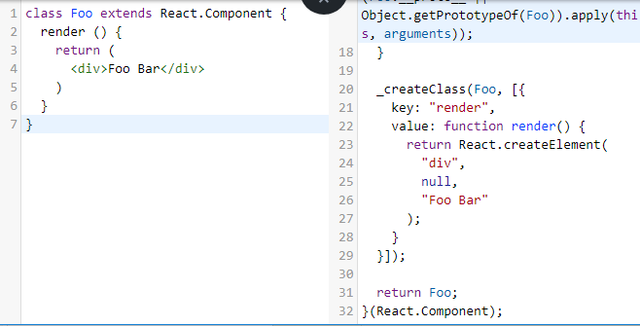
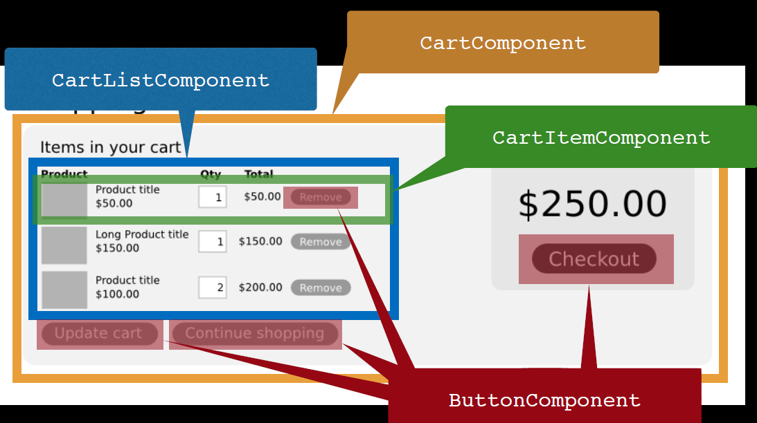
React features
JSX
JavaScript extension
Try it: http://babeljs.io/repl
Components
Reusable, Maintainable, Testable
The virtual DOM

Slide 14
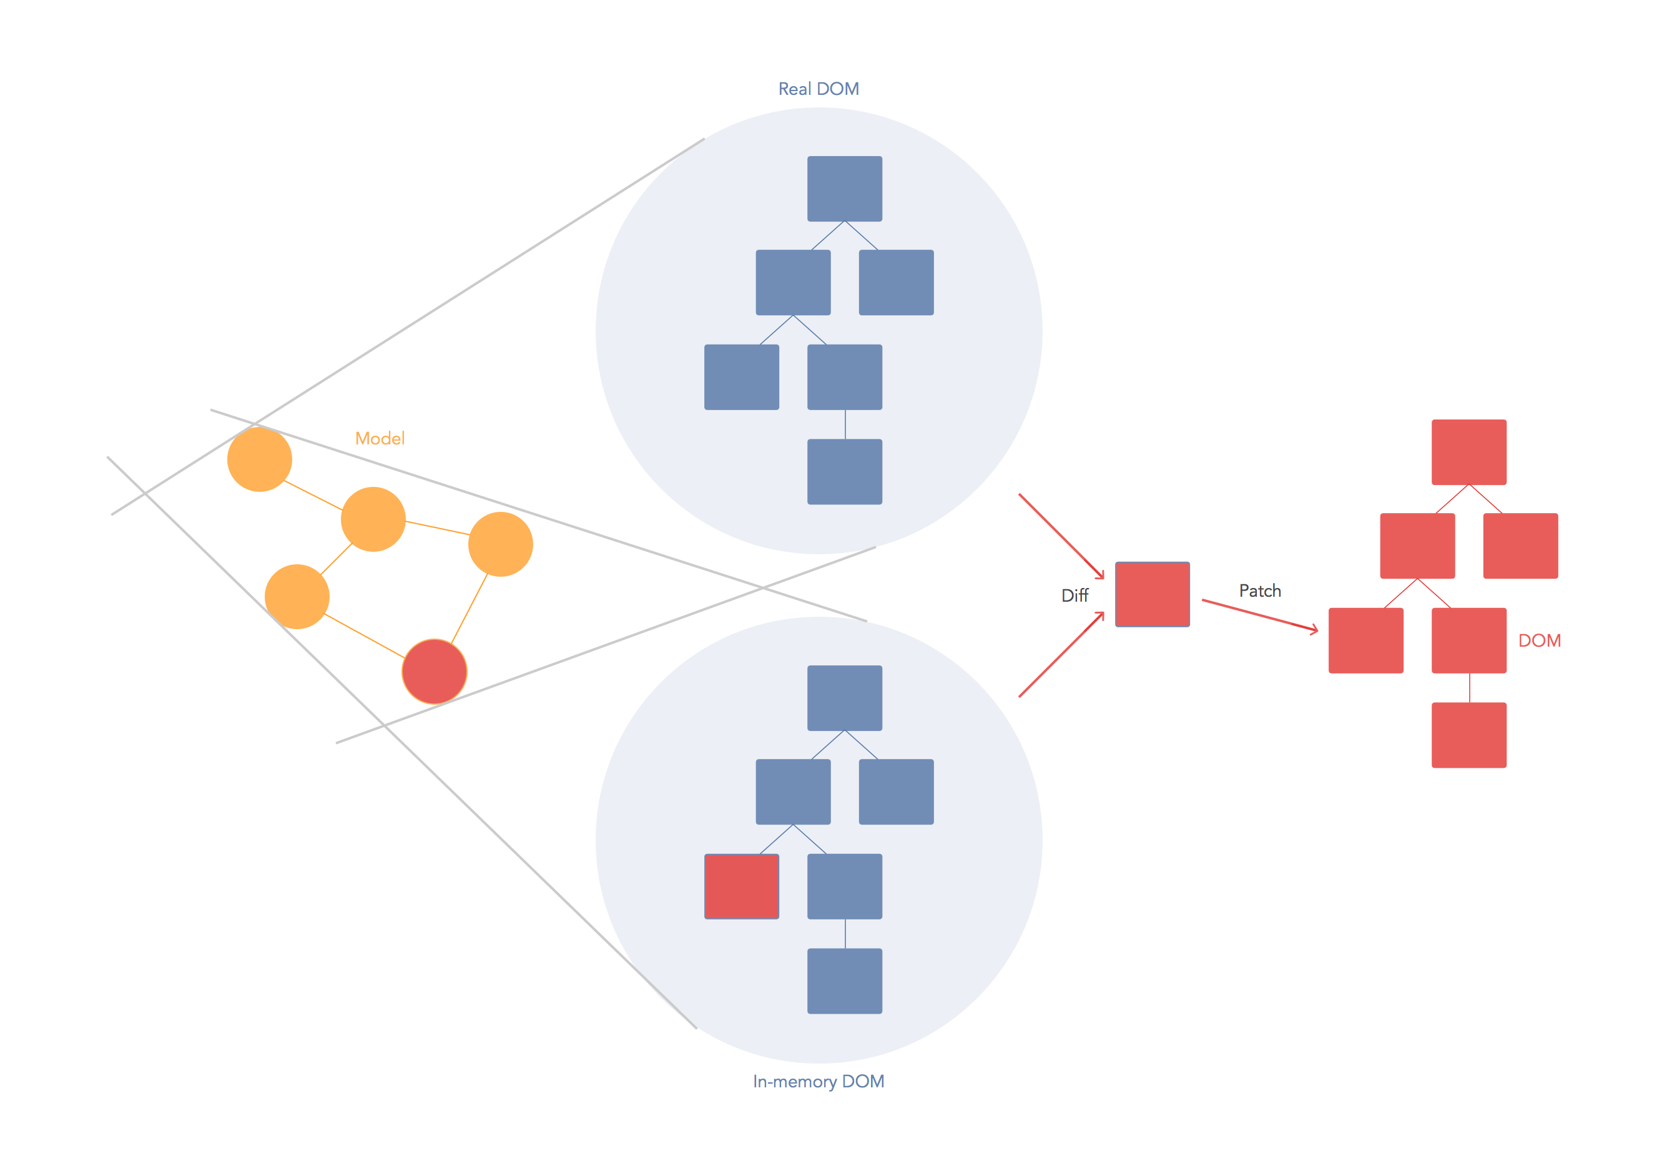
The virtual DOM
Reference: https://stackoverflow.com/questions/21109361/why-is-reacts-concept-of-virtual-dom-said-to-be-more-performant-than-dirty-mode

Slide 15
Setup
Softwares
node & npm
IDE: Web storm, VS Code, Atom, Sublime, vi
Quick start
npm install -g create-react-app
create-react-app my-app
cd my-app
npm start
Reference: https://reactjs.org/tutorial/tutorial.html

Slide 16
React: Start from scratch
Prepare and create package.json:
npm init -y
Install global package:
npm install -g babel babel-cli
npm install -g webpack-dev-server
Add dependencies and plugins:
npm install webpack webpack-dev-server --save
npm install react react-dom --save
npm install babel-core babel-loader --save
npm install babel-preset-react babel-preset-es2015 --save
Reference: https://www.tutorialspoint.com/reactjs/reactjs_environment_setup.htm

Slide 17
Compiler, Server and Loaders
create webpack.config.js
var config = {
entry: './src/index.js',
output: {
path:'/',
filename: 'bundle.js',
},
devServer: {
inline: true,
port: 8080
},
module: {
loaders: [
{
exclude: /node_modules/,
loader: 'babel-loader',
query: {
presets: ['es2015', 'react']
}
}
]
}
}
module.exports = config;

Slide 18
Compiler, Server and Loaders
edit package.json
"scripts": {
"start": "webpack-dev-server --hot"
"test": "echo \"Error: no test specified\" && exit 1"
},
npm start
index.html
app.jsx
main.js
<!DOCTYPE html>
<html lang = "en">
<head>
<meta charset = "UTF-8">
<title>React App</title>
</head>
<body>
<div id = "app"></div>
<script src = "index.js"></script>
</body>
</html>
import React from 'react’;
class App extends React.Component
{
render() {
return ( <div> Hello World!!! </div> );
}
}
export default App;
import React from 'react';
import ReactDOM from 'react-dom';
import App from './app.jsx';
ReactDOM.render(
<App />, document.getElementById('app')
);
Try to modify in app.jsx and check result at browser

Slide 19
Component based
import React from 'react';
class App extends React.Component {
render() {
return (
<div>
<Header/>
<Content/>
</div>
);
}
}
class Header extends React.Component {
render() {
return ( <div> <h1>Header</h1> </div> );
}
}
class Content extends React.Component {
render() {
return (
<div>
<h2>Content</h2> <p>The content text!!!</p>
</div>
);
}
}
export default App;
In practical, Header and Content should be separately created and exported.

Slide 20
Data passing (props vs. state)
React has 2 objects of data passing in order to control data into a component
Props
Pass from parent to child components
Immutable
Props CANNOT be CHANGED inside a component
Single source of the truth
Fixed throughout the component
State
Reside within component
Mutable
State CAN be CHANGED

Slide 21
Props: pass to a component
import React, { Component } from 'react'; class Foo extends Component { render() { return ( <div> <h1> Foo: {this.props.name} </h1></div> ) } } class App extends Component { render() { return ( <div> <Foo name="FooName" /> </div> ); } } export default App;
Define a new property ‘name’

Slide 22
State: initial and update
class App extends Component { constructor(props){ super(props) this.state = { fooState: "Foo State" } } render() { return ( <div> Message: {this.state.fooState} <br/> </div> ); } }
Initial state object
Read state object

Slide 23
State: bind method to context
class App extends Component { constructor(props){ super(props) this.state = { fooState: "Foo State" } this.updateMessage = this.updateMessage.bind(this) } updateMessage(e) { this.setState( {fooState: "New Foo State: "
+ e.target.value }) } render() { return ( <div> <div> Message: <input type='text' onChange={this.updateMessage}/> <br/> {this.state.fooState} <br/> </div> </div> ); } }
Have to bind method to ‘App’ context, otherwise a new method will not be known
Define the method to update state
Trig the method

Slide 24
State: automatically bind
class App extends Component { constructor(props){ super(props) this.state = { fooState: "Foo State" } } updateMessage = (e) => { this.setState( {fooState: "New Foo State: " + e.target.value }) } render() { return ( <div> <div> Message: <input type='text' onChange={this.updateMessage}/> <br/> {this.state.fooState} <br/> </div> </div> ); } }
Arrow function binds a method automatically

Slide 25
State: Parent and child component
class Foo extends Component { render() { return ( <div> <h3> Foo: {this.props.name} </h3> {this.props.fooState} </div> ) } } class App extends Component {
...
render() { return ( <div> <div> Message: <input type='text' onChange={this.updateMessage}/> <br/> {this.state.fooState} <br/> </div> <Foo name="FooName" fooState={this.state.fooState} updateMessage={this.updateMessage.bind(this)} /> </div> ); } }
Read ‘state’ as ‘props’
Pass ‘state’ as ‘props’
Update ‘state’ from parent but it affects to child component

Slide 26
React – AJAX Request
Promises: Axios library

Slide 27
HTTP Library: Axios
Target API: https://api.github.com/users/wwarodom
Example: axios
npm install axios --save
import React, { Component } from 'react'; import axios from 'axios'; const USER = 'wwarodom'; class Profile extends Component { constructor(props){ super(props) this.state = { data: {} } } componentDidMount() { axios.get(`https://api.github.com/users/${USER}`) .then(response => { this.setState({data: response.data}) console.log(response.data) } ) }
Send Http request

Slide 28
Read object
render() { const dataOption = Object.keys(this.state.data) .map( (key,index) => <option value={index}> {index+1 +'. ' +key+ ': ' + this.state.data[key]} </option> ) return ( <div> <h2> Github Profile</h2> <ul> <li>{this.state.data.url}</li> <li>{this.state.data.login}</li> <li>{this.state.data['blog']}</li> </ul> <dd><select>{dataOption}</select></dd> </div> ); } } export default Profile;
Pick a value

